Slide 1

Cloud Kitchen
Amit Sharma
Jayraj Radadiya
Anand Shroff
Rohit Yadav
Hanish Khattar
Project Management Analytics
Group 1
Section 003

Slide 2
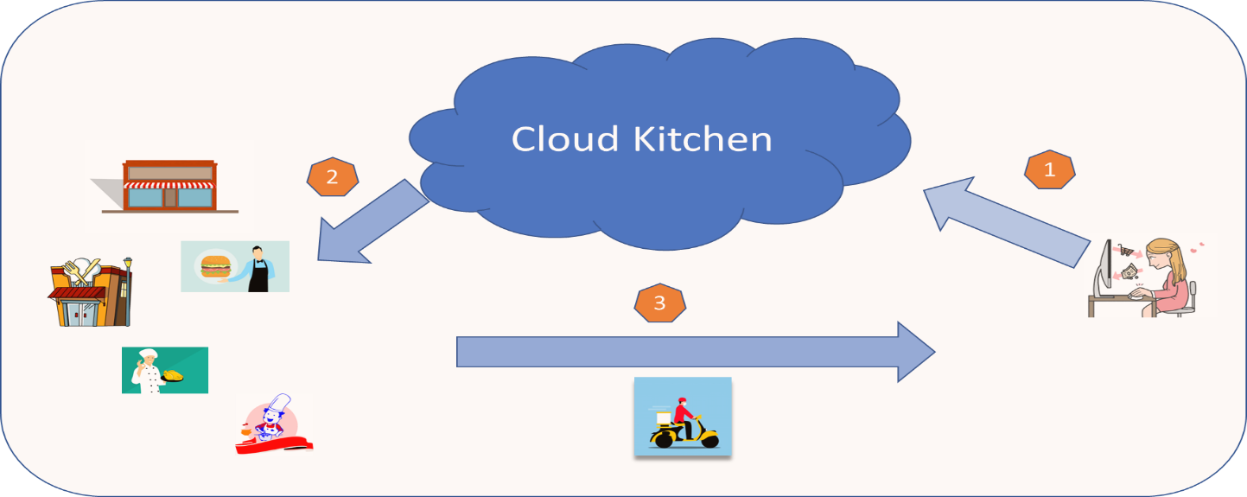
Overview
Every year, many immigrants and students arrive in Canada and discover themselves in a different country away from their home, culture, language, and cuisine. ‘Cloud Kitchen’ model is a model where both customers and Vendors can meet at a common platform, search for their preference of food (type, price, distance, and delivery model), pay online and get food delivered to their doorsteps. 'Cloud Kitchen' can be accessed via Web as well as phone apps for both customers and vendors, making it easily functional and usable for the user.

Slide 3


Timeline
Initiation
Development
Closure
Analysis and Planning
Post Development
Start of the project with Business plan and Charter. PM tries to get the signoff on the initial documents and starts preparing a plan
The work movement happens here: Designs, Development, Testing, measuring and management
Close books, learn lessons, talk to teams and move to next work
25 Nov’22
05 Jun’ 23
15 Nov’22
07 Apr’ 23
12 Jun’ 23
What need to done? Who is going to do it? How much time it will take? How many milestones need to be decided? How much it will cost? What are the risks? What if?
Final deliveries, checking KPIs, measuring against expectations , documenting things etc.
.

Slide 4
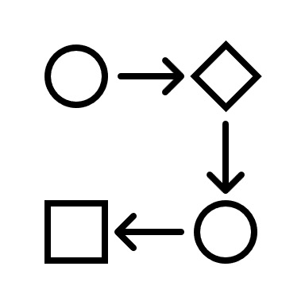
Project Flow/Process
Conception & Initiation
Definition & Planning
Launch or Execution
Performance and Control
Project Close
- Develop Project Charter
- Develop Preliminary Project Scope Statement
- Define Scope
- Develop Project Schedule
- Develop Risk Plans
- Develop Financial Plan
- Develop Project Management Plan
- Acquire Project Team
- Direct and Manage Project Execution
- Manage Team Performance
- Assure Quality
- Manage Project Communication
- Contracting with Subcontractors
- Monitor and Control project
- Change Control
- Scope Verification
- Schedule Control
- Manage Finances
- Perform Quality Control
- Performance Reports
- Manage Stakeholders
- Risk Monitoring
- Close Project
- Contract Closure

Slide 5


Conception & Initiation
The initiation phase marks the beginning of a project. In this phase, high-level decisions are made regarding why a project is needed, whether or not it can be done, and what is needed. It's most often associated with traditional, linear project management methodologies, but the high-level decisions are relevant for projects being managed using any methodology.
Documents and their state - per phase
- Business Case - Completed
- Project charter - Completed

Slide 6



Definition & Planning
Initiation is followed by ‘defining and planning’, from mapping out the scope to developing a schedule and working out the cost. There are two methods of planning and setting goals for projects that are popular with project managers
- SMART (Specific, Measurable, Attainable, Realistic and Timely)
- CLEAR (Collaborative, Limited, Emotional, Appreciable and Refinable)
Documents and their state - per phase
- WBS – Completed
- RACI Matrix - Initiated
- Stakeholder Register - Initiated
- Communication Plan - Initiated
- Cost & Budget - Initiated
- Resource Work Activities Chart - Initiated
MS Project Link
Notes:
Specific – the who, what, where, when, which and why in goal setting.
Measurable – measuring progress towards a goal’s success.
Attainable – how the goals will be achieved.
Realistic – that all team members are working together to achieve the goals.
Timely – a feasible timeline in which goals can be reached.
The CLEAR acronym, which has become popular in the last few years and adds another dimension to the second stage, stands for:
Collaborative – ensuring the team is happy and willing to work together.
Limited – ensuring the scope of the goals is limited so that they are manageable.
Emotional – forming an emotional connection to the goals by linking with team members’ passions.
Appreciable – large tasks and activities are broken down in to smaller pieces so that they are achievable.
Refinable – flexible, adaptable goals that can be fine-tuned in line with changes.

Slide 7


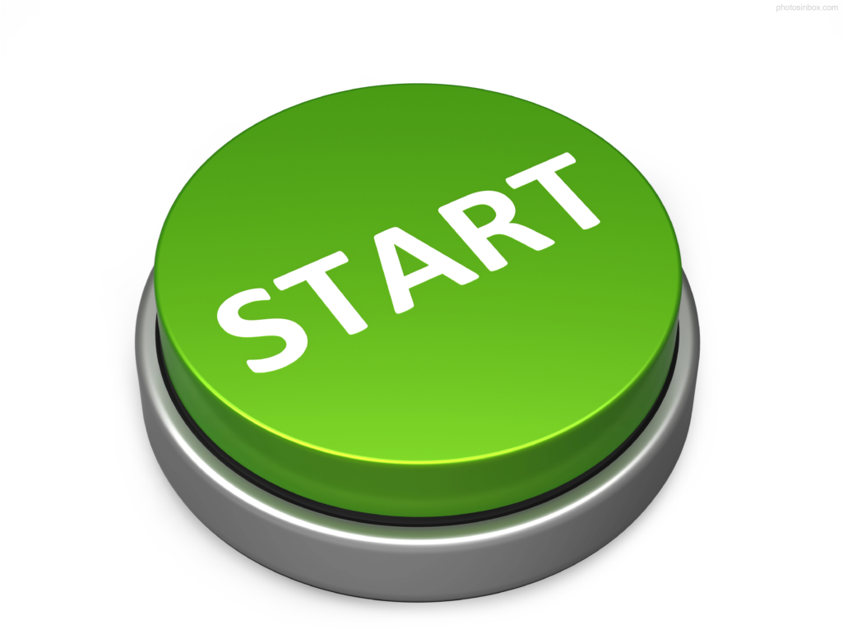
Launch or Execution
The third stage, once the project’s scope has been agreed, is where the actual physical work of the project starts. Teams meet to learn the project’s timelines and their responsibilities. Tasks are assigned, resources are distributed and other information related to the project is imparted. The project manager ensures that every team member knows what they need to do, and by when.
Most project managers at this stage establish a way of monitoring a project’s progress and communicating with team members regularly, such as project management software that helps a project run smoothly.
Documents and their state - per phase
- Changelog and Change Request – Initiated
- Lessons Learned Register - Initiated
- Stakeholder Register – Update
- RACI Matrix - Update
- Stakeholder Register - Update
- Communication Plan - Update
- Cost & Budget - Update

Slide 8



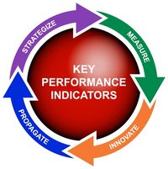
Performance and Control
This stage runs the entire length of the project and is a crucial part of a project’s success. Regular communication with team members is a must. This allows the project manager to monitor, measure and manage progress, and to iron out any issues that may arise.
KPIs (Key Performance Indicators) can be used to assess progress. They can help identify areas where deadlines may have been missed, resources weren’t available on time or when a situation needs to be resolved.
Documents and their state - per phase
- Changelog and Change Request – Update
- Lessons Learned Register - Update
- RACI Matrix - Completed
- Stakeholder Register - Completed
- Communication Plan - Completed
- Cost & Budget – Completed
- Resource Work Activities Chart - Completed
Notes:
KPIs (Key Performance Indicators) can be used to assess progress. There are generally four KPI aspects that are followed:
Project objectives
Quality deliverables
Effort tracking
Project performance

Slide 9

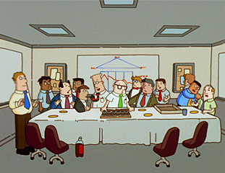

Project Close
The final project management stage is completing the project, with the handover to the owner. At this point, the client will, hopefully, approve and accept the project. Contracts with suppliers are terminated and a final budget and project report is produced. All relevant documentation is collated and filed, and the project team is rewarded.
Developing and managing a project based around these five stages gives every project manager the greatest opportunity to bring a project to its successful completion.
Documents/Activities and their state
- Final Team meeting - Completed
- Lessons Learned Register - Completed
- Project Closure report - Completed

Slide 10
Thank you.

